Slide 1

Text Sentiment Analysis from Social Media
Presented by – G.Gowthami

Slide 2

Introduction
In the digital world, people express opinions and emotions through platforms like social media, reviews, and blogs. Sentiment analysis helps understand the emotional tone behind this text data. Manually analyzing this data for sentiment is inefficient and time-consuming. This project presents a Python-based Sentiment Analyzer using the VADER model from the NLTK library, integrated with a simple GUI built using Tkinter . Users can input any text, and the system classifies it as Positive, Negative and Neutral. It is fast and ideal for basic sentiment evaluation.

Slide 3
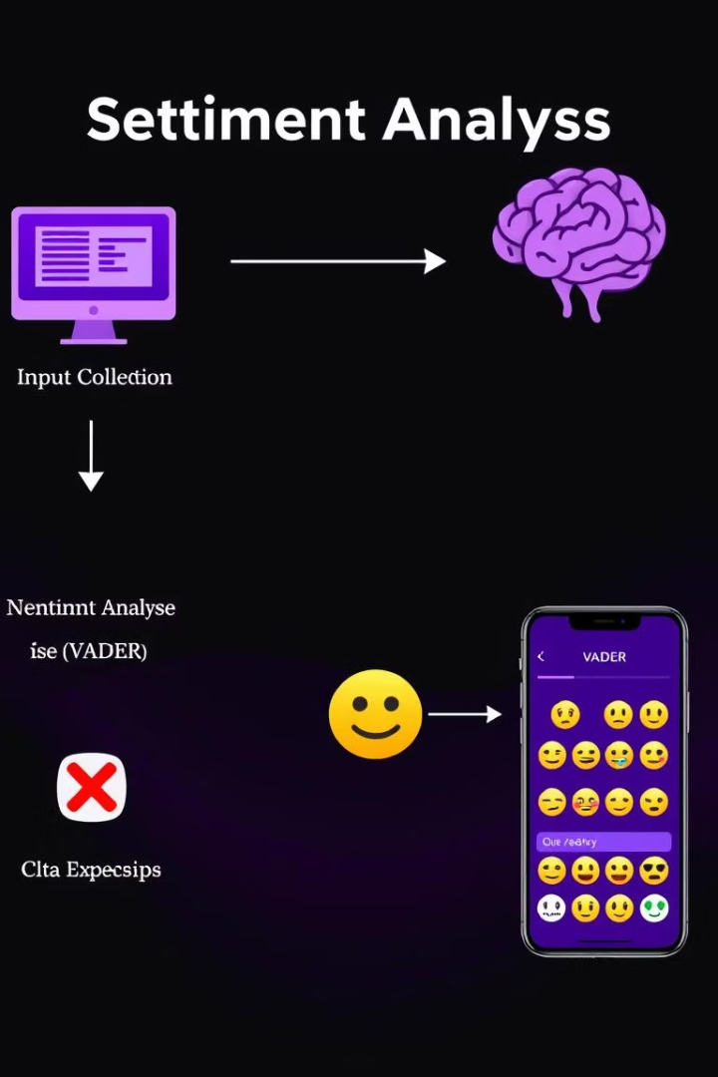
Methodology : Analyzing Text Sentiment
1
Input Collection
Users input text through a graphical interface.
Sentiment Analysis
2
Input text is analyzed using the VADER sentiment analysis model from the NLTK library.
Classification
3
Based on the compound score, the sentiment is classified into Positive (≥ 0.05),
Negative (≤ -0.05),
Neutral (between -0.05 and 0.05).
4
GUI Interaction
The sentiment result is displayed with color-coded text and emojis for better user experience.

Slide 4

VADER Sentiment Analysis
VADER – Stands for Valence Aware Dictionary and sentiment Reasoner.
Lexicon + Rule-based sentiment analysis tool.
Specially tuned for social media/text data.
Uses a predefined dictionary of words with sentiment scores.
Considers intensifiers, negations, and punctuation to improve accuracy.
VADER outputs four scores: Positive, negative, neutral, and compound. The compound score, ranging from -1 to 1, represents the overall sentiment polarity of the input text.
VADER Output:

Slide 5

How Algorithm works:
Here the steps:
Take a sentence or text as input.
Convert to lowercase.
Remove unnecessary punctuation
Tokenize the sentence into words.
For each word, get its valence score from the VADER lexicon (range: -4 to +4).
Adjust each word’s score based on:
Booster words (e.g., "very", "extremely") → increase intensity.
Negations (e.g., "not good") → flip or decrease score.
Punctuation (e.g., "!!!", "??") → amplify score.
Capitalization (e.g., "GOOD") → amplify if only that word is capitalized.
Conjunctions (e.g., "but") → gives more weight to the second clause.
Step -1 : Input Text
Step -2:Preprocessing
Step -3:Valence Lookup
Step -4:Apply Heuristics

Slide 6
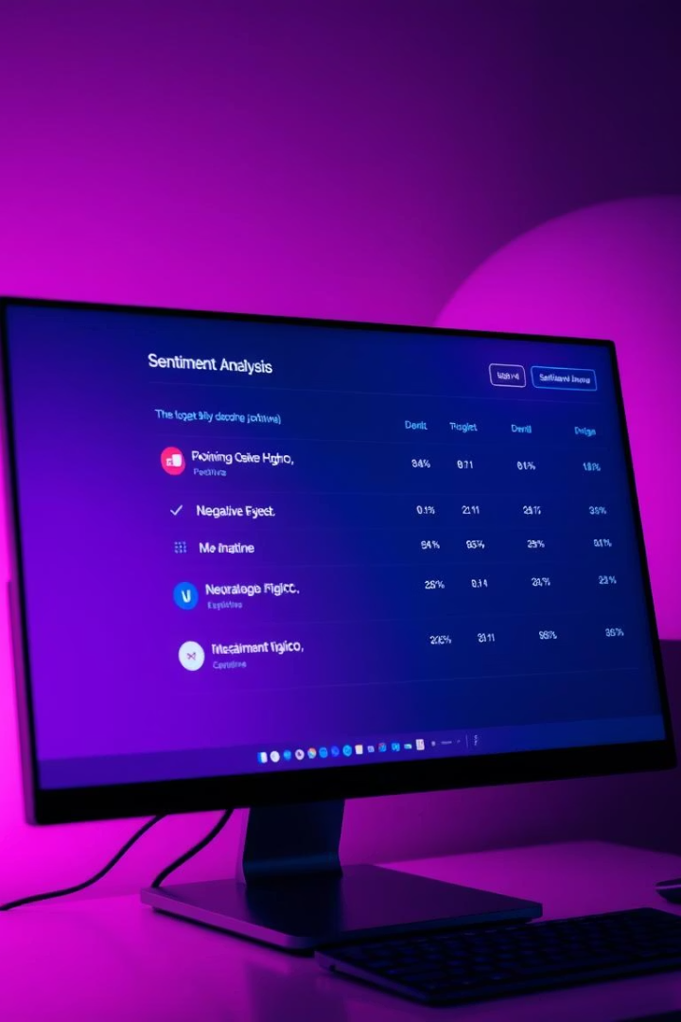
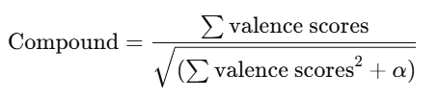
Sum the adjusted valence scores of all words.
α is a normalization constant (typically 15)
Result is between -1 (most negative) and +1 (most positive).
compound ≥ 0.05 → Positive
compound ≤ -0.05 → Negative
else → Neutral
Step -5 : Combine Scores
Step -6 : Normalize the compound Score
Step -7 : Classify sentiment

Slide 7
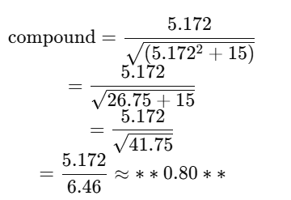
Step-by-Step VADER Compound Score Calculation
Sentence: "The food was absolutely amazing!“
VADER splits the sentence into words: ["the", "food", "was", "absolutely", "amazing"]
"amazing" → +4.0 (positive word)
"absolutely" → booster word, boosts the next word's score by 0.293
So adjusted score:
Other words (the, food, was) → Neutral, score = 0
Only "amazing" (boosted) contributes:
Sum = 5.172
Final Compound Score: 0.80
Which means strongly positive sentiment.
Step -1 : Tokenization
Step -2 : Valence Lookup from lexicon
Step -3 : Sum of valence scores
Step -4: Normalization (compound score Formula

Slide 8



Example Outputs
Positive Sentiment Example
"The customer service was amazing, and I had a great experience.”
Negative Sentiment Example
“This is the worst product I have ever used. Completely disappointed."
Neutral Sentiment Example
"I went to the store and bought some groceries."

Slide 9








Technologies Used
Python
Core language for the project.
NLTK
Provides VADER and text utilities.
Tkinter
GUI toolkit for user interface.
VADER Lexicon
Pre-trained sentiment rules.

Slide 10

Performance and Limitations
Accuracy : Suitable for basic sentiment.
Scalability : Designed for individual use.
The analyzer is fast and suitable for basic sentiment analysis.
However, it is limited in scalability and accuracy for complex text.

Slide 11
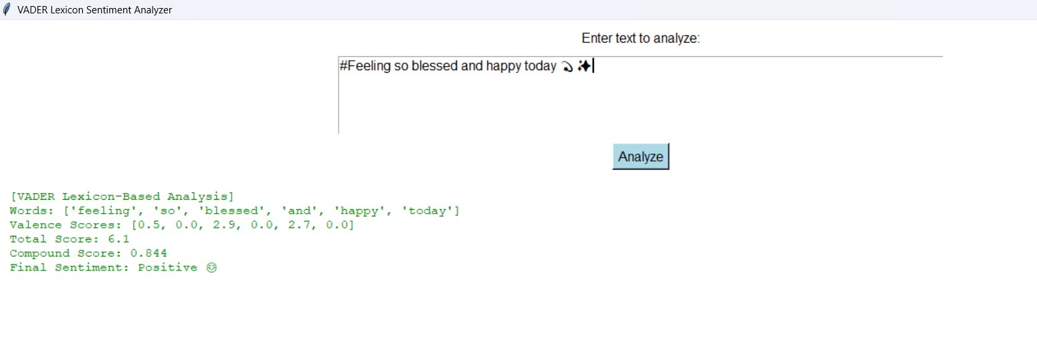
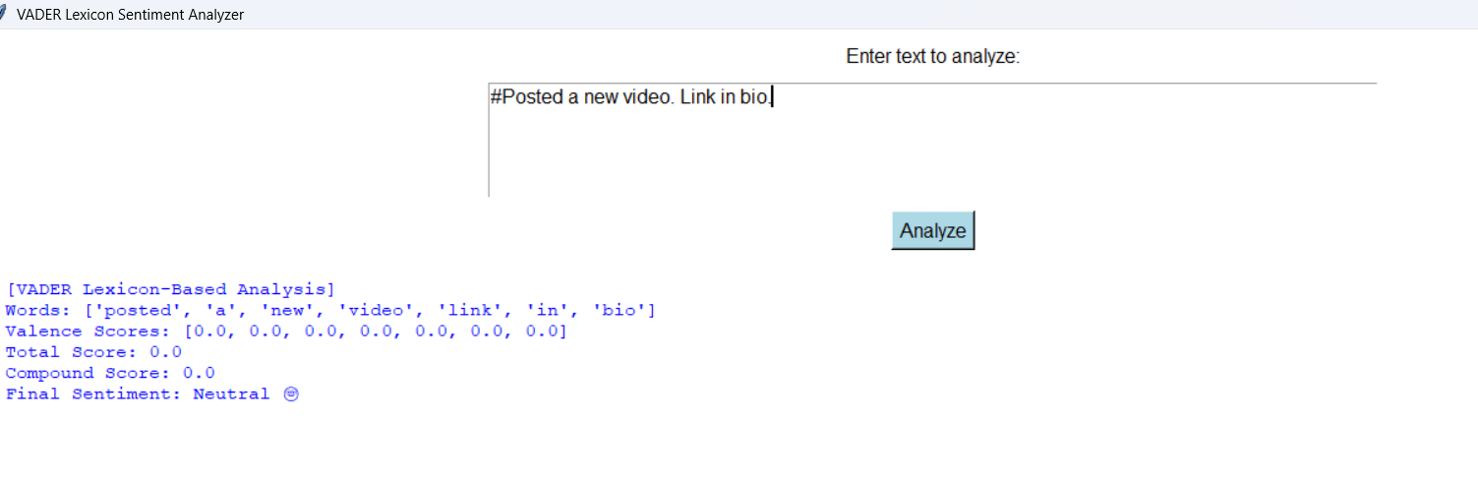
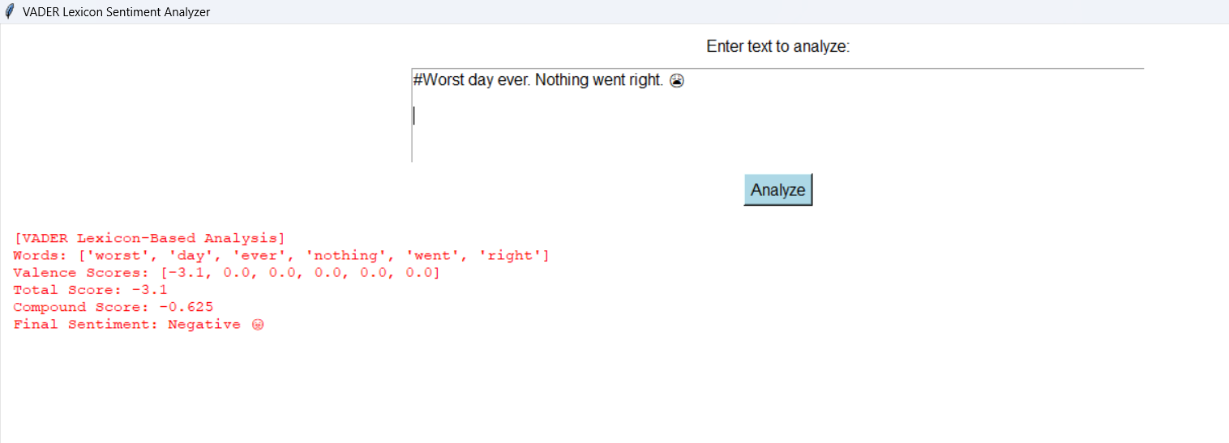
Results

Slide 12

Conclusion
This project delivers a straightforward, real-time sentiment analysis tool built with Python, VADER, and Tkinter. It accurately categorizes text as Positive, Negative, or Neutral through an intuitive GUI. It is ideal for quick sentiment checks, learning NLP concepts, or gaining small business insights. The tool is fast, lightweight, and effectively handles informal language.

Slide 13
Future Scope
Some of the possible future improvements include:
Integrating social media APIs for real-time data
Replacing VADER with deep learning models like BERT
Adding multilingual support
Building web or mobile interfaces
G.Gowthami

Slide 14
References
Veena, G., Vinayak, A., & Nair, A. J. (2021). Sentiment Analysis using Improved VADER and Dependency Parsing. In 2021 2nd Global Conference for Advancement in Technology (GCAT) (pp. 1–6). IEEE.
Hutto, C. J., & Gilbert, E. (2014).VADER: A Parsimonious Rule-Based Model for Sentiment Analysis of Social Media Text. Proceedings of the Eighth International AAAI Conference on Weblogs and Social Media (ICWSM-14), pp. 216–225.
G.Gowthami

Slide 15
Thank you
G.Gowthami

